Slide 1
FORTREX DATABASE GUI DESIGN
MADE BY: PARAS & REVANTH
GUIDED BY: PROF. T. RAGUNATHAN

Slide 2
GUI LOGIN PAGE
Login page contains the welcome content for the project along with some of the pictures of the interface, the contact details and about us.
Header contains login and signup button that opens a popup and shows the form to enter through.
After login header will contain the profile picture as an avatar of the user for the database.
Footer will contain copyright of the developers.

Slide 3
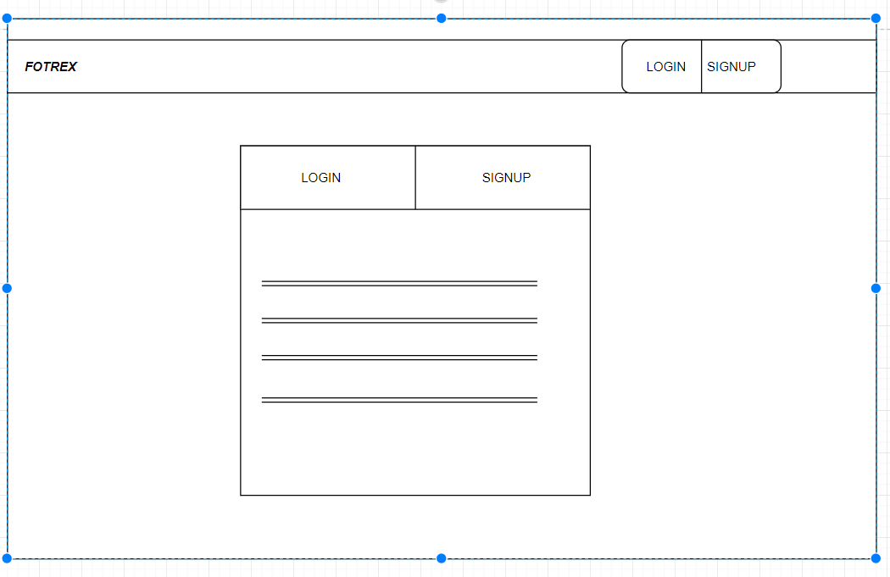

Slide 4
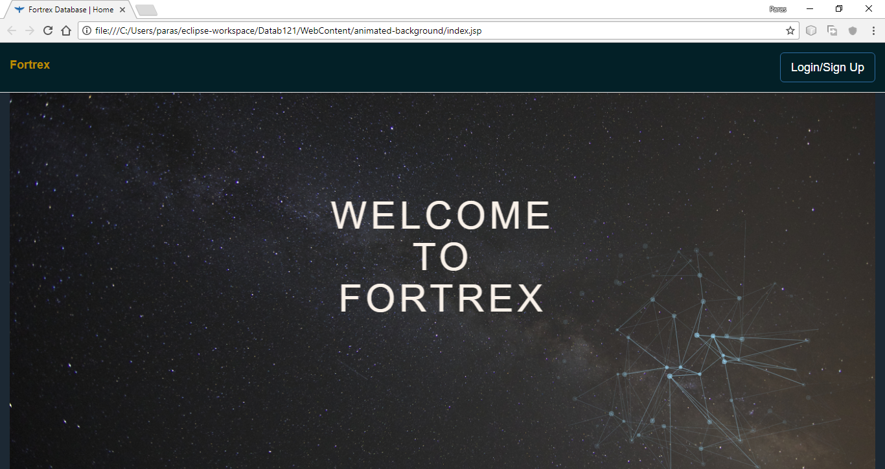

Slide 5
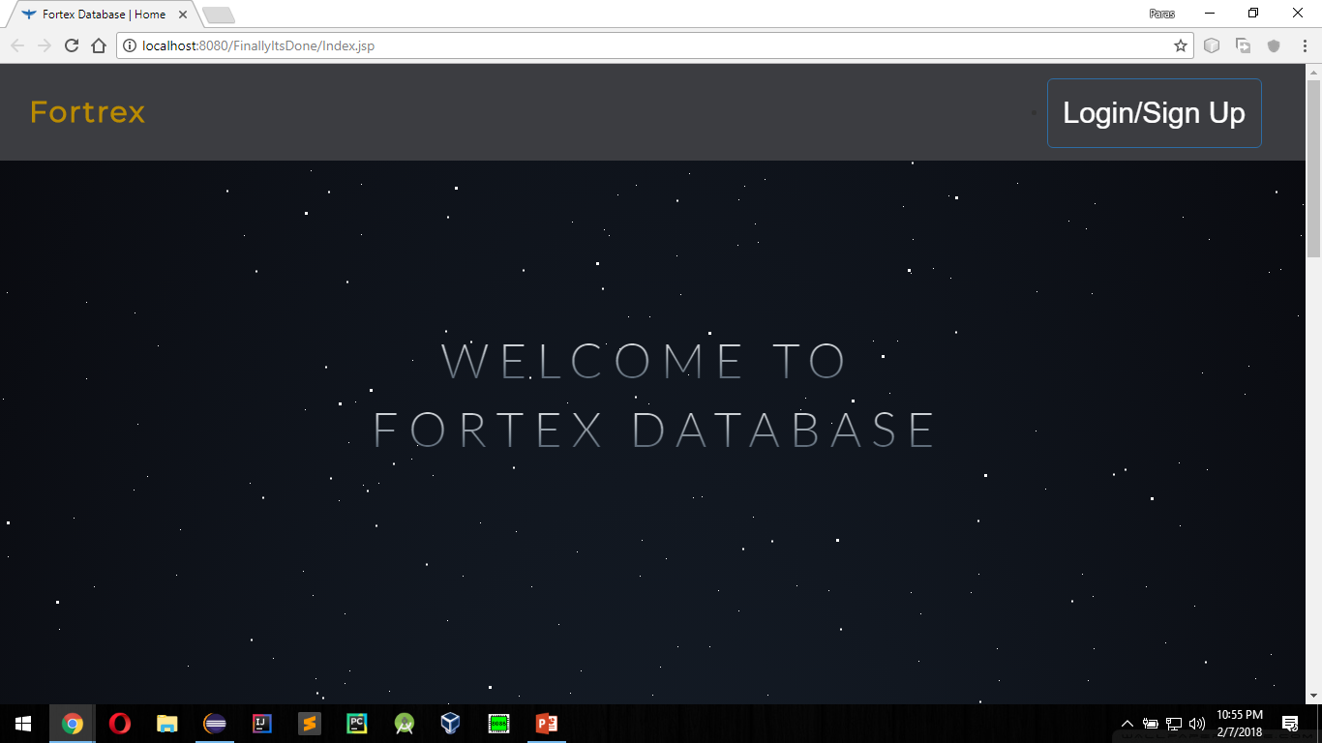

Slide 6
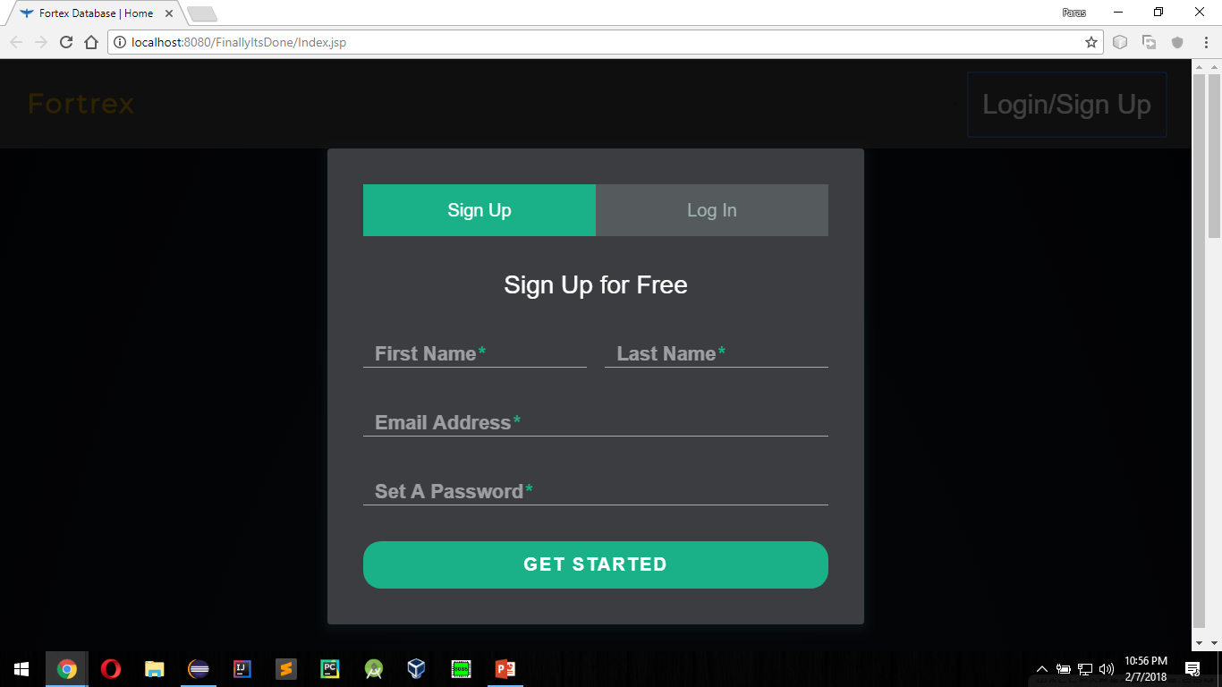

Slide 7
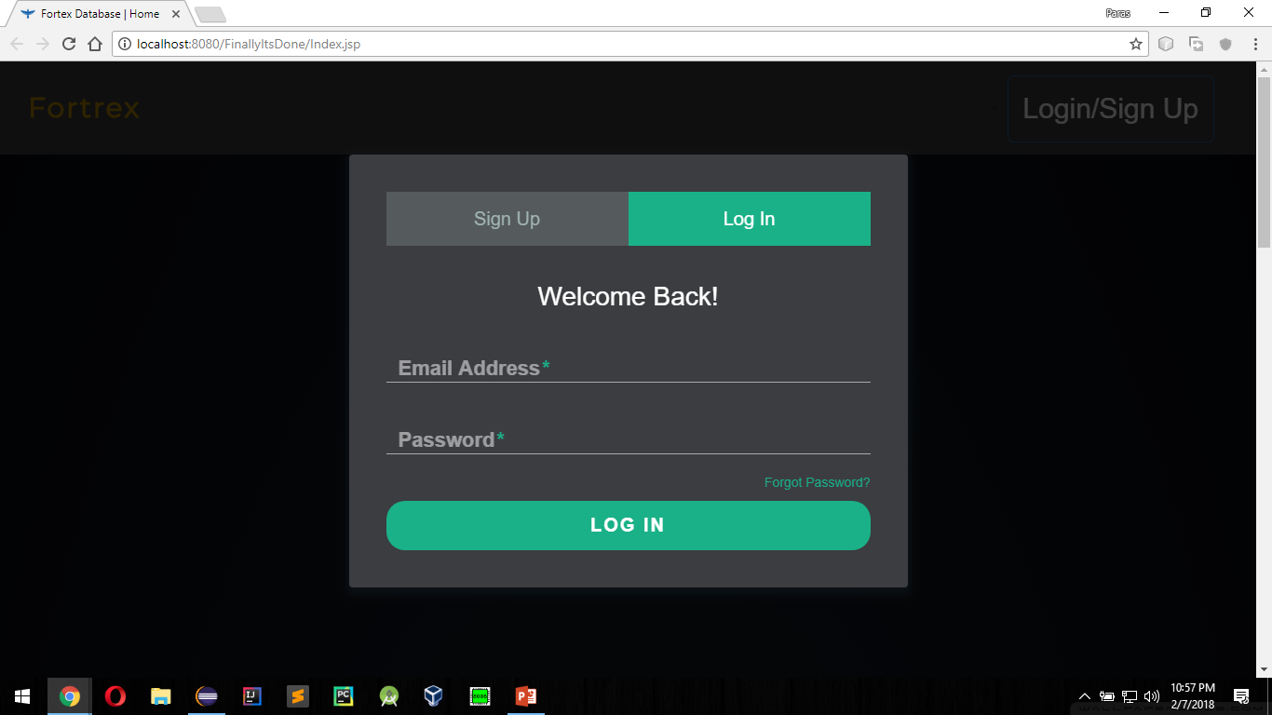

Slide 8


Slide 9
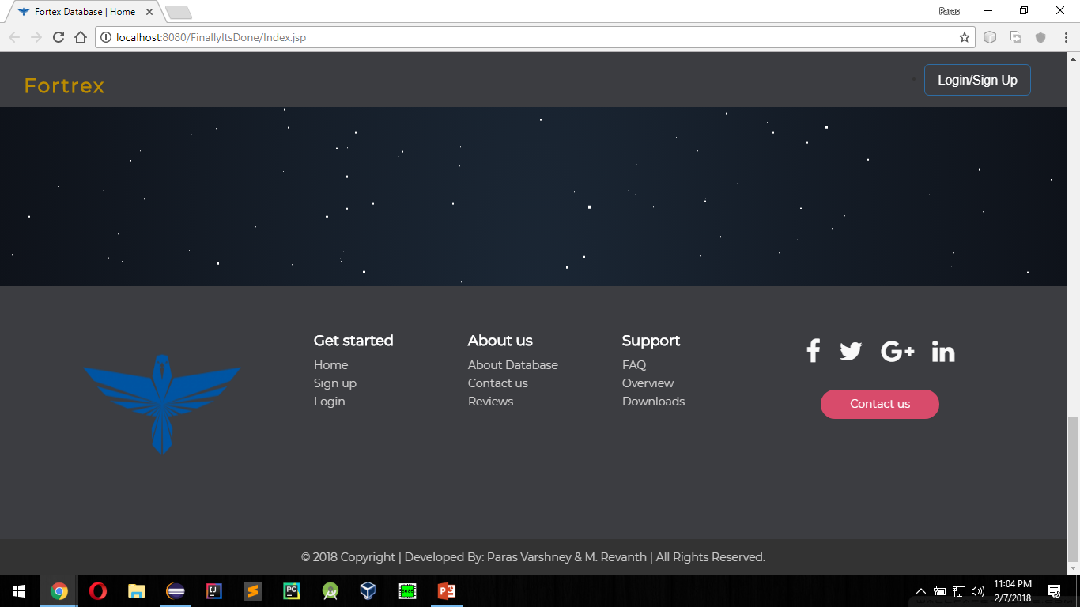

Slide 10
MAIN PAGE
The main page contains all the functionalities for the database including
all the queries
Displaying relations
Displaying databases
Deleting tables and databases
Joining tables
Etc.

Slide 11
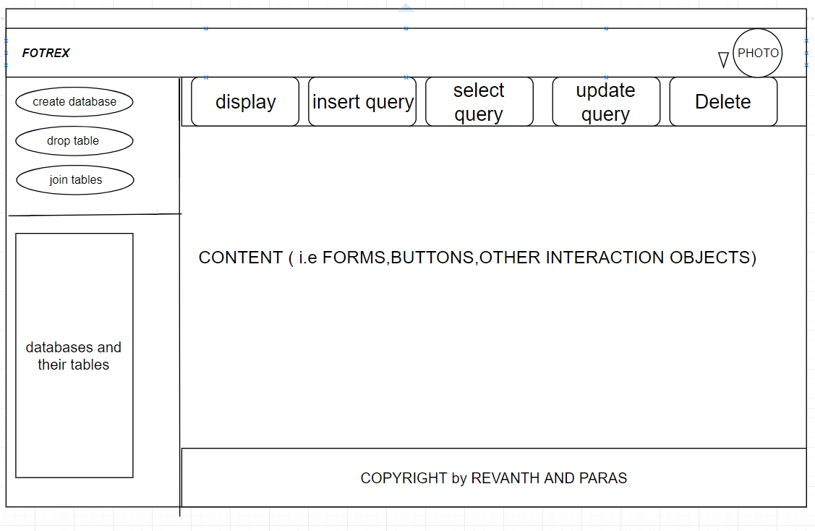

Slide 12
THIS IS THE BASIC GUI DESIGN SCHEMA FOR THE PROJECT AND IS SUBJECTED TO BE CHANGE (IMPROVED) AS PER THE TIME BEING.

Slide 13
THANKYOU

